Slide 1
Computer Forensics Gerhard Steinke

Slide 2
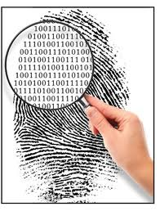
Computer Forensics
Identifying, preserving, analyzing and presenting digital evidence in a manner that is legally acceptable…
Gathering and analyzing data … to reconstruct data or what has happened in the past on a system

Slide 3
What can Computer Forensics do?
Discover data that resides in a computer system
Recover files that have been deleted, encrypted, or damaged
Collect, analyze and present computer data to a Court of Law
Provide evidence in cases of computer crime or misuse
Notes:
3

Slide 4
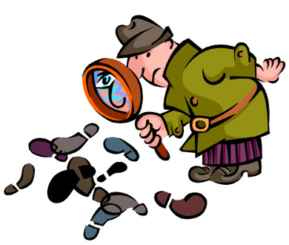
Forensics Process
Secure the (crime) scene
Note date and start/end time of exam
Leave computer in original state
Photograph the suspect computer
Image Capture – Make another copy of the hard drive
Image Processing - index and extract data from all areas of the target image.
Analyze and report
Notes:
4

Slide 5

Computer Forensics Capabilities
Safe seizure of computer systems and files, avoiding contamination and/or interference
Safe and non-contaminating copying of disks and other data media
Recovery / reconstruction of deleted files
Recovery of data from "swap" and "cache" files
Collecting an image of the contents of the active memory of a computer at a particular time – core dump
Review of single computer for "proper" working during relevant period, including service logs, fault records, etc.

Slide 6
Computer Forensics Methods
Inter-action with third parties, e.g. suppliers, emergency response teams, law enforcement agencies
Use of purpose-written search programs to examine the contents of a file
Examination of telecoms devices, location of associated activity logs and other records perhaps held by third parties
Event reconstruction
Notes:
6

Slide 7
Forensic Tools: Logging
Provides invaluable clues as to what's going on in your system as well as to what others are attempting to do with your system.
Understand each service on your machines and its logging capabilities.
Know where your logs are and learn how to analyze them.

Slide 8
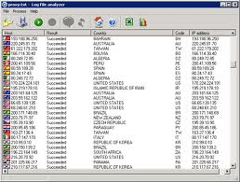
Automated analysis of logs
Tools help by summarizing activity and establishing a base-line of normal activity to help detect suspicious behavior.

Slide 9
Log Files
Log utility allows systems administrators to log various events occurring on the systems
Disable the ability for another machine to log to your syslogd
Set the logging level as verbose as disk space will allow
Log to a separate file system.
Enable logging of as many system services as possible.
Older logs should be dumped to tape or transferred to another system for archival.

Slide 10
Port Scanners
Tools used by both attackers and defenders to identify computers active on a network and other useful information
Can scan for specific types of computers, protocols, or resources, or their scans can be generic
The more specific the scanner is, the better it can give attackers and defenders useful information

Slide 11
Vulnerability Scanners
Active vulnerability scanners scan networks for highly detailed information
Initiate traffic to determine holes
Passive vulnerability scanners listen in on network and determine vulnerable versions of both server and client software
Administrators feel wary of using the same tools that attackers use?
In order to defend a computer or network well, it is necessary to understand ways it can be attacked

Slide 12
Packet Sniffers
Network tool that collects copies of packets from network and analyzes them
Can provide network administrator with valuable information for diagnosing and resolving networking issues
In the wrong hands, a sniffer can be used to eavesdrop on network traffic
To use packet sniffer legally, administrator must be on network that organization owns, be under direct authorization of owners of network, and have knowledge and consent of the content creators

